Slide 1
Newell Highway Upgrade Project
28 km of Newell Highway
Single carriageway, single lane in each direction
Highest heavy vehicle traffic in NSW
Black soil country
Annual flood risk

Slide 2
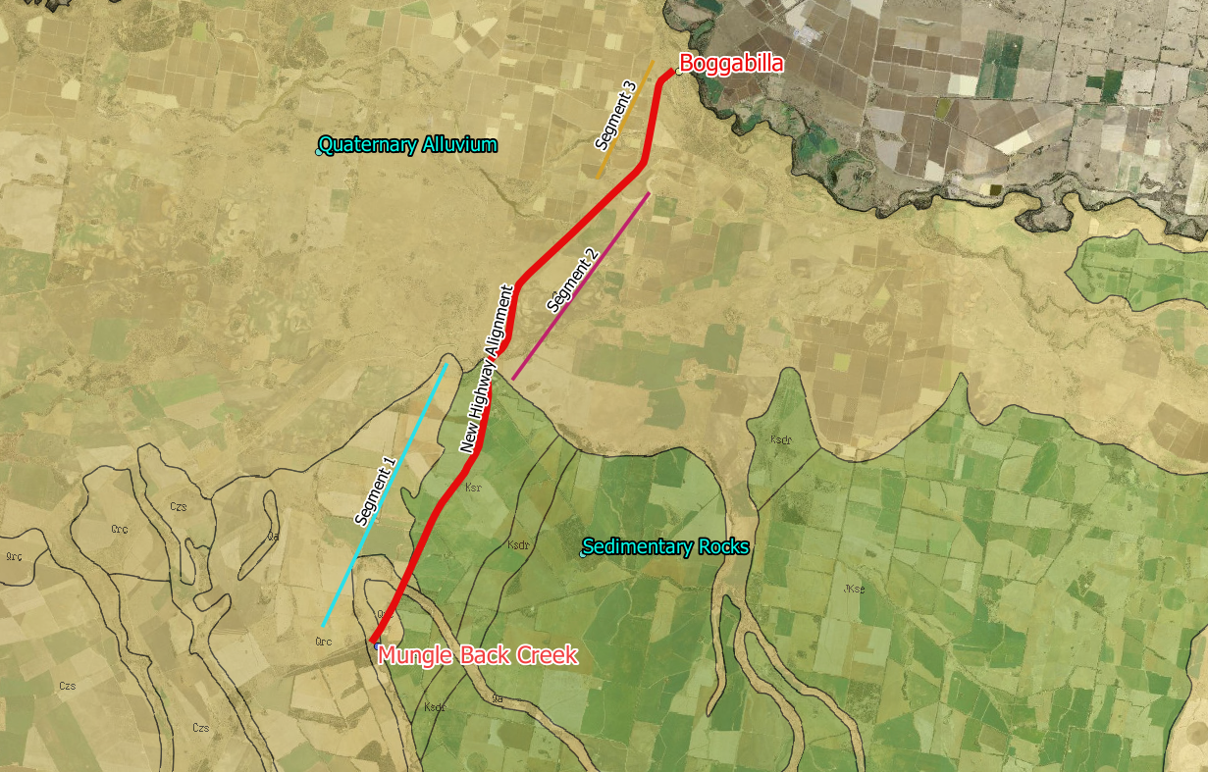
Regional Geology

Slide 3
Scope of Investigation
DP provided:
investigation services;
factual reporting for submission to RMS; and
laboratory testing.

Slide 4
Scope of Investigation
114 Test pits (shoulder, embankment, verge, offline)
32 Pavement bores
12 Piezometers (with monitoring for 16 months)

Slide 5
Scope of Investigation – Laboratory Testing
Subgrade
CBR testing (4 day, 10 day and 21 day soak) – 105 tests;
Atterberg limits – 71 tests;
Particle size distribution including hydrometer – 24 tests;
Emerson – 21 tests
Acid sulfate testing – 50 tests
Pavement Materials
CBR testing (4 day soak) – 16 tests
Atterberg limits – 16 tests
Particle size distribution including hydrometer – 16 tests;
Verge, Cutting and Bridge Sized Structures
CBR testing (10 day soak) – 10 tests;
Atterberg limits – 10 tests
Particle size distribution including hydrometer – 10 tests;
Emerson - 4 tests
Acid sulfate testing – 45 tests
Soil Aggressivity testing – 8 tests

Slide 6
Scope of Investigation – Laboratory Testing
Subgrade
CBR testing (4 day, 10 day and 21 day soak) – 105 tests;
Atterberg limits – 71 tests;
Particle size distribution including hydrometer – 24 tests;
Emerson – 21 tests
Acid sulfate testing – 50 tests
Pavement Materials
CBR testing (4 day soak) – 16 tests
Atterberg limits – 16 tests
Particle size distribution including hydrometer – 16 tests;
Verge, Cutting and Bridge Sized Structures
CBR testing (10 day soak) – 10 tests;
Atterberg limits – 10 tests
Particle size distribution including hydrometer – 10 tests;
Emerson - 4 tests
Acid sulfate testing – 45 tests
Soil Aggressivity testing – 8 tests

Slide 7
Scope of Investigation – Laboratory Testing
130 – 1 per 200 m
Predominantly on subgrade
Foamed Bitumen Stabilisation of Pavement
Subgrade lime stabilisation

Slide 9
Existing Pavement
Poor quality base and subase material
40 mm to 50 mm AC
CBR = 8% to 45% (8 tests)
Clay and silt content = 17% – 23%
PI = 4% to 13%
160 mm to 250 mm Base
100 mm to 300 mm Subbase (generally less than 200 mm)
CBR = 4.5% to 14% (8 tests)
Clay and silt content = 35% – 50%
PI = 5% to 17%
Clay and Sandy Clay Subgrade
Shallow subgrade (30 tests)
CBR = 1.5% to 12%
Clay and silt content = 36% – 93%
PI = 18% to 59%
Weak Subgrade
Deep Subgrade (20 tests)
CBR = 1.5% to 5%
Clay and silt content = 56% – 90%
PI = 31% to 49%

Slide 10
What is foamed bitumen?
It is a mixture of air, water and bitumen
The characteristics include:
Once a foaming agent is mixed, it expands about 15 times
Large surface area and low viscosity
When mixed with gravel material, the droplets coat the finer particles that binds them together

Slide 11
What benefits?
Unbound Pavement
Bitumen foam stabilised pavement
Sourced from Wirtgen Group, “Binder with a proven track record worldwide, foamed bitumen”
Increases strength through stabilisation
Modulus increases significantly, shear strength gains (similar to that of cement treated material) but with higher flexibility
Higher flexibility reduces risk of fatigue (cemented material)
Decreases the permeability of the pavement
Less susceptible to heavy rainfall (i.e. copes with weather)

Slide 12
What Disadvantages?
Not suitable for all pavements
Purpose built equipment needed
More expensive than other stabilisation methods

Slide 13
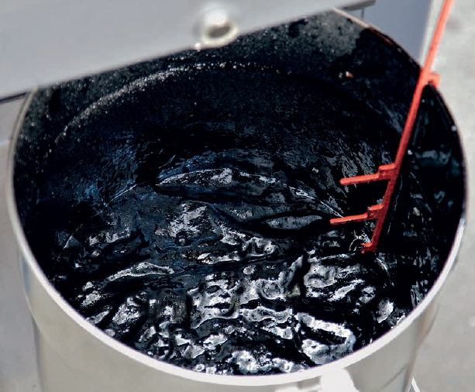
Costs over $50k

Slide 14
Where has it been done in Aus?
Queensland Main Roads
1.6 km of Cunningham Highway at Gladfield (near Warwick)
Gympie
Inglewood

Slide 15
Advantages for Pavement Design
The fatigue relationship for asphalt can be used in calculations (CIRCLY), as follows
N = RF${\left(\frac{6918(0.856VB+1.08) }{S_{mix}^{} µƐ}\right)}^{5}$
Where: N = allowable repetitions
S_{mix} = Modulus of foamed bitumen stabilised material
V_{B} = % by volume of bitumen in the stabilised material
RF = reliability factor (=1 for rehabilitation)
This means greater allowable repetitions for the same thickness of pavement layers
RMS puts a cap on S_{mix} of 2500 Mpa (close to some asphalts)

Slide 16
Suitability Assessment
Differs for RMS and QMR
RMS
Binder (RMS R76)
Foamed bitumen expansion ratio of 10 and minimum half life of 20 seconds
Particle distribution as for Material to be bound (RMS 3051)
Plasticity requirements (Austroads PI<10%) – lime can be added to reduce plasticity
Test material with foamed bitumen to obtain average resilient modulus
Plot the average resilient modulus against binder content to determine bitumen application rate require to satisfy table below

Slide 17
Suitability Assessment
Blend D meets minimum initial resilient modulus and also minimum soaked resilient modulus
Gravel 2.1 and 2.3 do not meet minimum initial resilient modulus

Slide 18
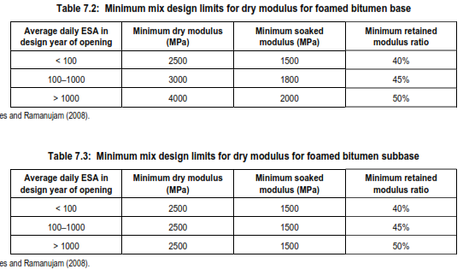
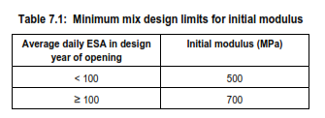
Austroads Design Procedure for Foamed Bitumen
Initial Modulus (needed because it is assumed that the road will be open within 3 hours of stabilisation)
Long Term Modulus (based on laboratory trials)
Adjustments for climate, rate of load

Slide 19
Austroads Design Procedure for Foamed Bitumen
Then the following fatigue relationship is used in calculations (CIRCLY)
greater allowable repetitions for the same thickness of pavement layers
RMS puts a cap on S_{mix} of 2500 Mpa (close to some asphalts)

Slide 20
Austroads Design Procedure for Foamed Bitumen
Minimum Surface Requirements
< 1x10⁷ ESA Spray seal or hot mix AC
≥ 1x10⁷ ESA 30 to 40 mm AC (minimum)

Slide 21
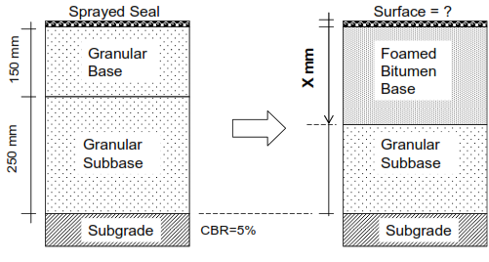
Austroads Design Procedure for Foamed Bitumen
Example
5 x 10⁶ ESA
Check Uncracked and cracked phase for bound base
300 mm
Reconstruction
(Austroads Mechanistic)
480 mm thickness
(Base and Subbase)
100 mm
Existing Road
(poorly performing)
Proposed Stabilised Road

Slide 22
Newell Highway Proposed Stabilisation
Remove about 300 mm
Lime stabilise remaining subbase and subgrade blend
Re-use top 300 mm with foamed bitumen stabilisation

Slide 23
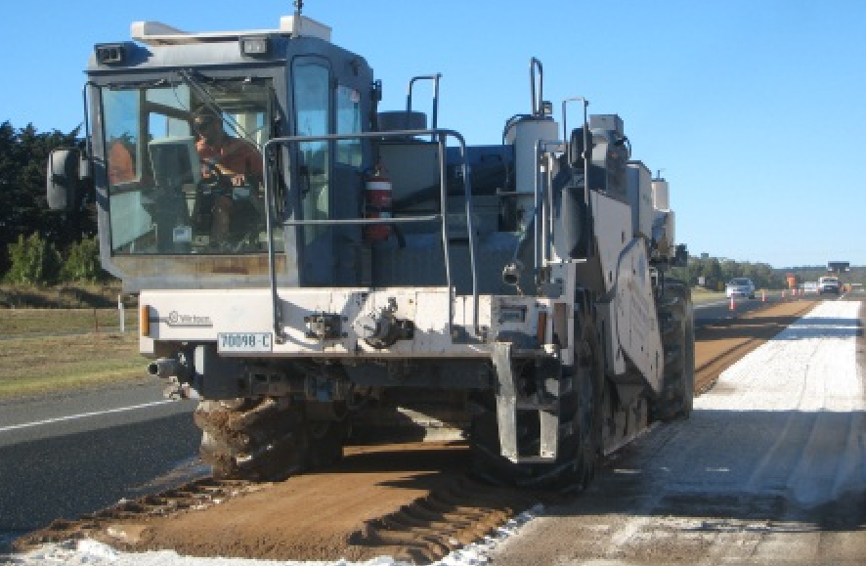
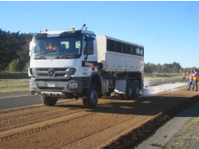
Foamed Bitumen Stabilisation Process
Normal Stabilisation Process
Run stabilised through the pavement (to stabilisation depth) to mix AC and basecourse
Apply quicklime to the surface
Slake quicklime
Mix the slake lime through the pavement
Shape and lightly compact
Apply foaming agent to hot asphalt in tank and stabilise through pavement

Slide 24
Proposed Newell Highway Stabilisation Process
Excavate to the proposed stabilisation depth
Stockpile material
Stabilise additional 300 mm of existing subbase and subgrade with 8% to 10% lime (LSF + 2%)
Compact the stabilised material
Place stockpiled material on exposed surface
Apply quicklime to the surface
Slake quicklime
Mix the slake lime through the pavement
Shape and lightly compact
Apply foaming agent to hot asphalt in tank and stabilise through pavement

Slide 25
Lime Demand Test
Measure the amount of lime to return mix to pH of Lime
This is the Lime Saturation Factor – (LSF)
Need to add more than the LSF before permanent modification of material occurs

Slide 26
Testing Regime
Two Methods UCS v CBR
UCS testing of subgrade blends with lime
Trialled different mixes at LSF LSF+2, LSF+4
Lime, quicklime, hydrated lime
Aim to get UCS of 2.5 MPa @ 28 days
CBR testing on subgrade blends
Mixes at LSF, LSF+2, LSF+4
Aim to get increase in soaked CBR to allow improvement in thickness design and better support for foamed bitumen basecourse

Slide 27
CBR Method
Subgrade 3.5%
Deep Subgrade 2.5%
Pavement Subgrade 3.5%
Offline Subgrade 4.0%
3%
Overall Subgrade after 110 tests???

